Slide 1
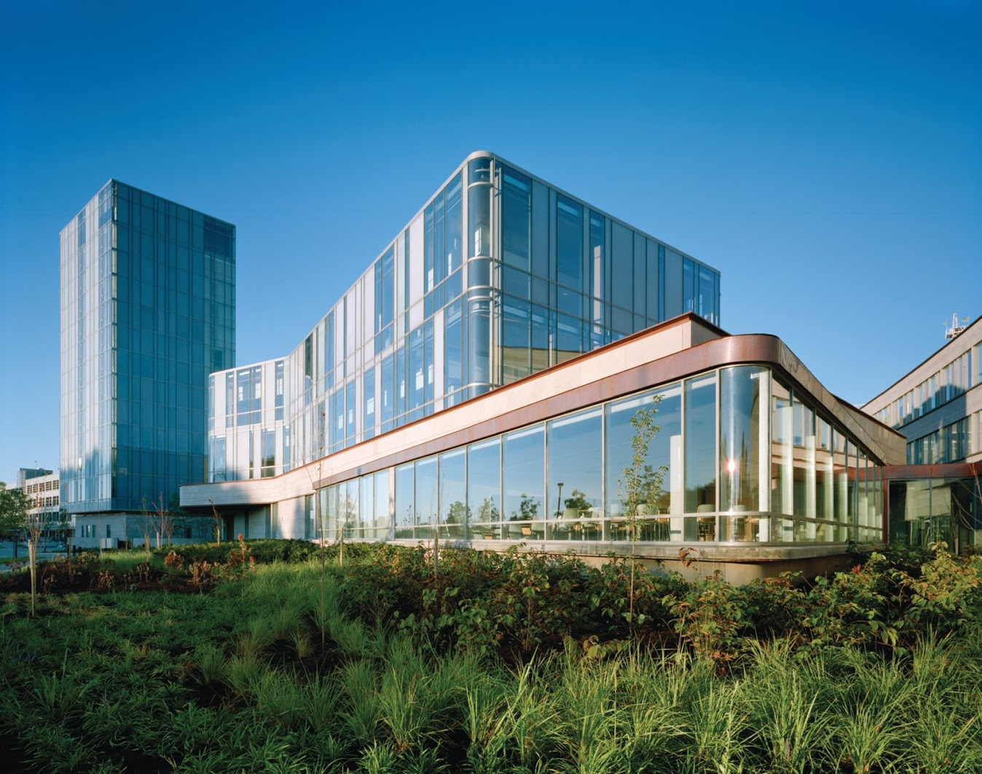
`
Schulich School of Business MMAI 5090
Week 1 : Probability and statistics review
Business applications of artificial intelligence II
Instructor: Boris Garbuzov
MMAI 5090
Summer 2021
SCHULICH SCHOOL OF BUSINESS | MMAI 5090
MODULE 1
Business applications of artificial intelligence II
2020

Slide 2
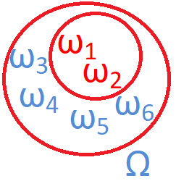

Probability review. Probability space
Random experiment
Example 1: toss a coin
Possible outcomes: {H,T}
Example 2: toss a dice
Possible outcomes: {“1”, “2”,…,”6”}
Example 1: A₁={H}
Example 2: A₂={even}={2,4,6}
P(A) – probability
P(A₁)=1/2
P(A₂)=1/2
ω_{i}- elementary outcomes
Ω= {ω₁, ω₂, ω₃,…} - set of all elementary outcomes
A= {ω₁, ω₂} - event
Read "1.2 Probability models" in "Probability and Statistics The Science of Uncertainty", by Evans and Rosenthal, at URL
http://www.utstat.toronto.edu/mikevans/jeffrosenthal/chap1.pdf
Some content of this slide is taken from https://en.wikipedia.org/wiki/Probability

Slide 3
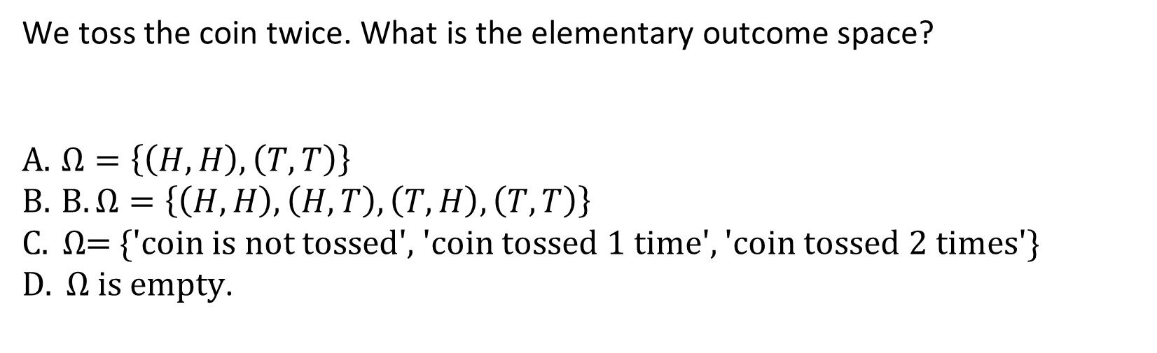
Probability space. Quiz practice
We toss the coin twice. What is the elementary outcome space?
$Ω=\left\{\left(H,H\right), \left(T,T\right)\right\}$
$B. Ω=\left\{\left(H,H\right), \left(H, T\right), \left(T, H\right), \left(T,T\right)\right\}$
$C. Ω$= {'coin is not tossed', 'coin tossed 1 time', 'coin tossed 2 times'}
$D. Ω is empty$.

Slide 4
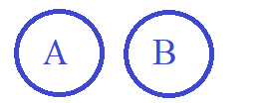
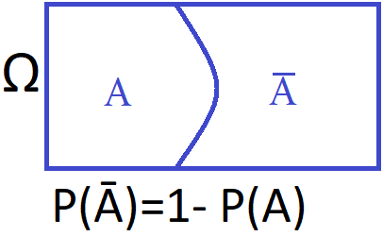
Probability review. Probability
Ø empty set
P(Ø)=0, P(Ω) =1
Disjoint events AꓵB= Ø
P(AꓴB)=P(A)+P(B)
Exercise:
Prove: for any A,B
P(AꓴB)=P(A)+P(B)-P(AꓵB)
Ω is a rectangle
Complement
Read "1.2 Probability models" and "1.3 Properties of Probability Models" in "Probability and Statistics The Science of Uncertainty", by Evans and Rosenthal, at URL http://www.utstat.toronto.edu/mikevans/jeffrosenthal/chap1.pdf

Slide 5
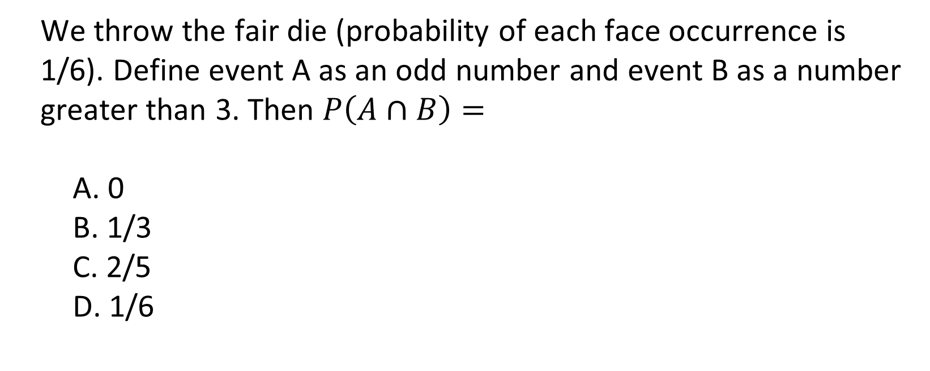
Probability. Quiz practice
We throw the fair die (probability of each face occurrence is 1/6). Define event A as an odd number and event B as a number greater than 3. Then $P\left(A∩B\right)=$
0
1/3
2/5
1/6

Slide 6
Probability review. Conditional probability
 | Smoker | Non-smoker
male | 0.15 | 0.35 | 0.5
female | 0.05 | 0.45 | 0.5
 | 0.2 | 0.8
P(S|F)= P(S ꓵ F)/P(F) = 0.05/0.5 = 0.1
Independence
A and B independent if P(AꓵB)= P(A)P(B) or P(A|B)=P(A)
Read "1.5 Conditional Probability and Independence" in "Probability and Statistics The Science of Uncertainty", by Evans and Rosenthal, at URL http://www.utstat.toronto.edu/mikevans/jeffrosenthal/chap1.pdf

Slide 7
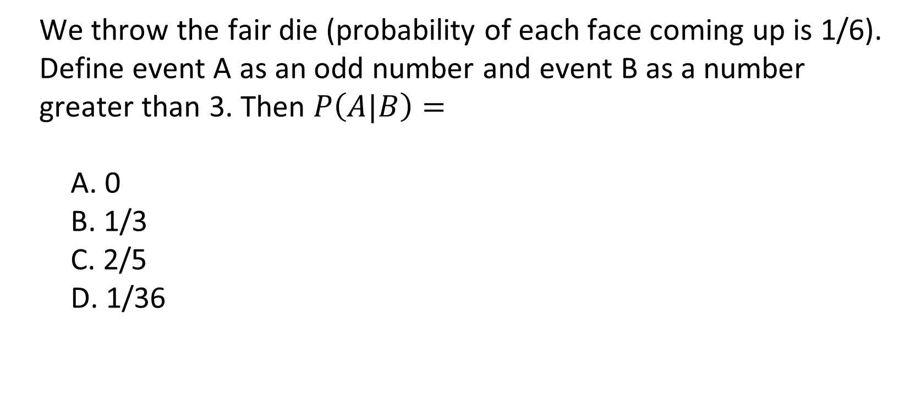
Conditional probability. Quiz practice
We throw the fair die (probability of each face coming up is 1/6). Define event A as an odd number and event B as a number greater than 3. Then $P\left(A|B\right)=$
0
1/3
2/5
1/36

Slide 8
Probability review. Bayes's theorem
For events H₁, H₂,…, H_{k} such that P(H_{i})>0,
Bayes’s theorem
Read "1.5 Conditional Probability and Independence" in "Probability and Statistics The Science of Uncertainty", by Evans and Rosenthal, at URL http://www.utstat.toronto.edu/mikevans/jeffrosenthal/chap1.pdf

Slide 9
Probability review. Bayes's theorem example
S – Smoker; - Non-smoker; F- Female; - Male
 | S
F | 0.05 | 0.45 | 0.5
 | 0.15 | 0.35 | 0.5
 | P(S)=0.2 | = 0.8
Read "1.5 Conditional Probability and Independence" in "Probability and Statistics The Science of Uncertainty", by Evans and Rosenthal, at URL http://www.utstat.toronto.edu/mikevans/jeffrosenthal/chap1.pdf

Slide 10
Bayes formula. Quiz practice
In Bayes theorem, events H_i should satisfy the conditions:
Pairwise disjoint
Independent
Their intersection is the whole elementary outcome space.
There could be no more than two of them.

Slide 11
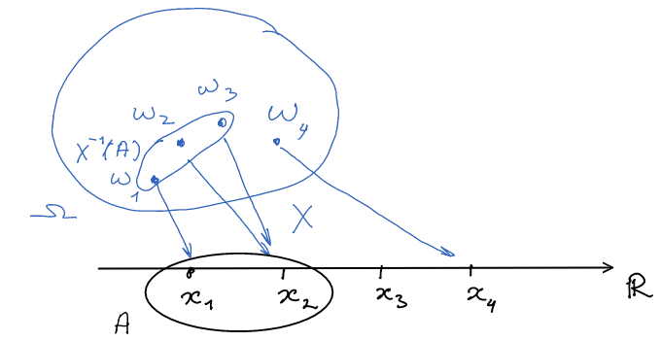
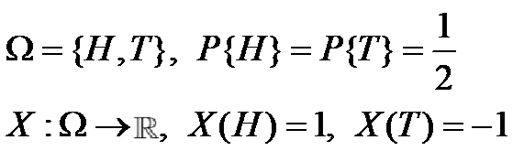
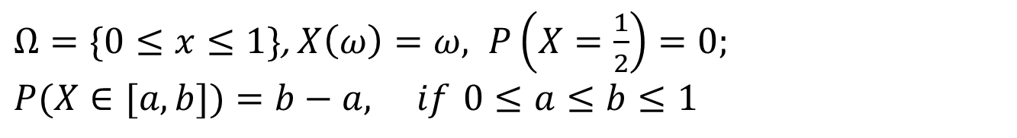
Probability review. Random variable
Example 1:
Example 2: A random point on the interval [0,1]
$Ω=\{0≤x≤1\}$, $X\left(ω\right)=ω, P\left(X=\frac{1}{2}\right)=0;$
$$P(X∈[a,b])=b−a, if 0≤a≤b≤1$$
Read "2.1 Random Variables" and "2.2 Distributions of Random Variables" in "Probability and Statistics The Science of Uncertainty", by Evans and Rosenthal, at URL http://www.utstat.toronto.edu/mikevans/jeffrosenthal/chap2.pdf

Slide 12

Random variable. Quiz practice
We play a game by throwing a pair of fair dice. Our profit X is a sum of both outcomes. Then $P\left(X=12\right)=$
1.5
1/6
1/7
1/36

Slide 13
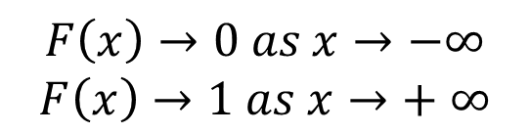
Probability review. Cumulative distribution function (CDF)
F
1
$$F\left(x\right)→0 as x→−∞$$
$$F\left(x\right)→1 as x→+ ∞$$
Examples.
1/2
x
-1
0
1
Uniform [0,1]. ω – abstract, x(ω)Є[0,1] F_{X}(x)=x, when x in [0,1]
F
Random variables
1
Discrete
CDF is a
Step function
Continuous
CDF is a
Continuous function
x
0
1
Read "2.5 Cumulative Distribution Functions" in "Probability and Statistics. The Science of Uncertainty", by Evans and Rosenthal, at URL http://www.utstat.toronto.edu/mikevans/jeffrosenthal/chap2.pdf

Slide 14

Cumulative distribution function. Quiz practice
I throw a die. Let X be a number coming up. Then the value of cdf at a point of 100 is $F_{X} \left(100\right)=$
0
1/100
2
1

Slide 15
Probability review. Discrete random variable
Probability mass function (pmf) f_{X}(x)=P{X=x}
Example.
f
1
x
-1
0
1
Read "2.3 Discrete Distributions" in "Probability and Statistics The Science of Uncertainty", by Evans and Rosenthal, at URL
http://www.utstat.toronto.edu/mikevans/jeffrosenthal/chap2.pdf

Slide 16
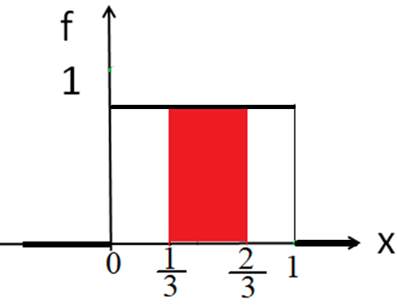
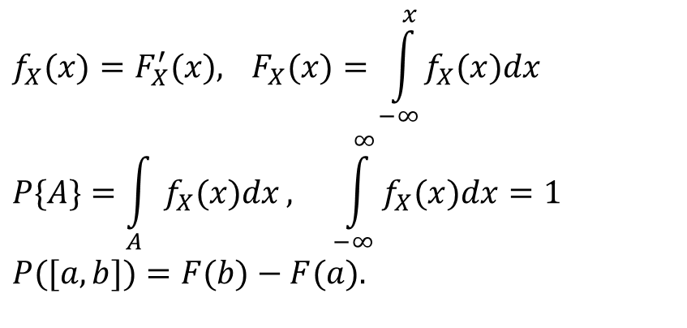
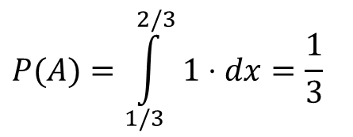
Probability review. Continuous random variable
Probability density function (pdf)
Example. Uniform [0,1]
$$f_{X}(x)=F_{X}^{′}(x), F_{X}(x)=\int_{−∞}^{x}{f_{X}(x)dx} \\ P\{A\}=\int_{A}{f_{X}(x)dx}, \int_{−∞}^{∞}{f_{X}(x)dx}=1 \\ P([a,b])=F(b)−F(a).$$
$$P(A)=\int_{1/3}^{2/3}{1}⋅dx=\frac{1}{3}$$
Read "2.4 Continuous Distributions" in "Probability and Statistics The Science of Uncertainty", by Evans and Rosenthal, at URL http://www.utstat.toronto.edu/mikevans/jeffrosenthal/chap2.pdf

Slide 17
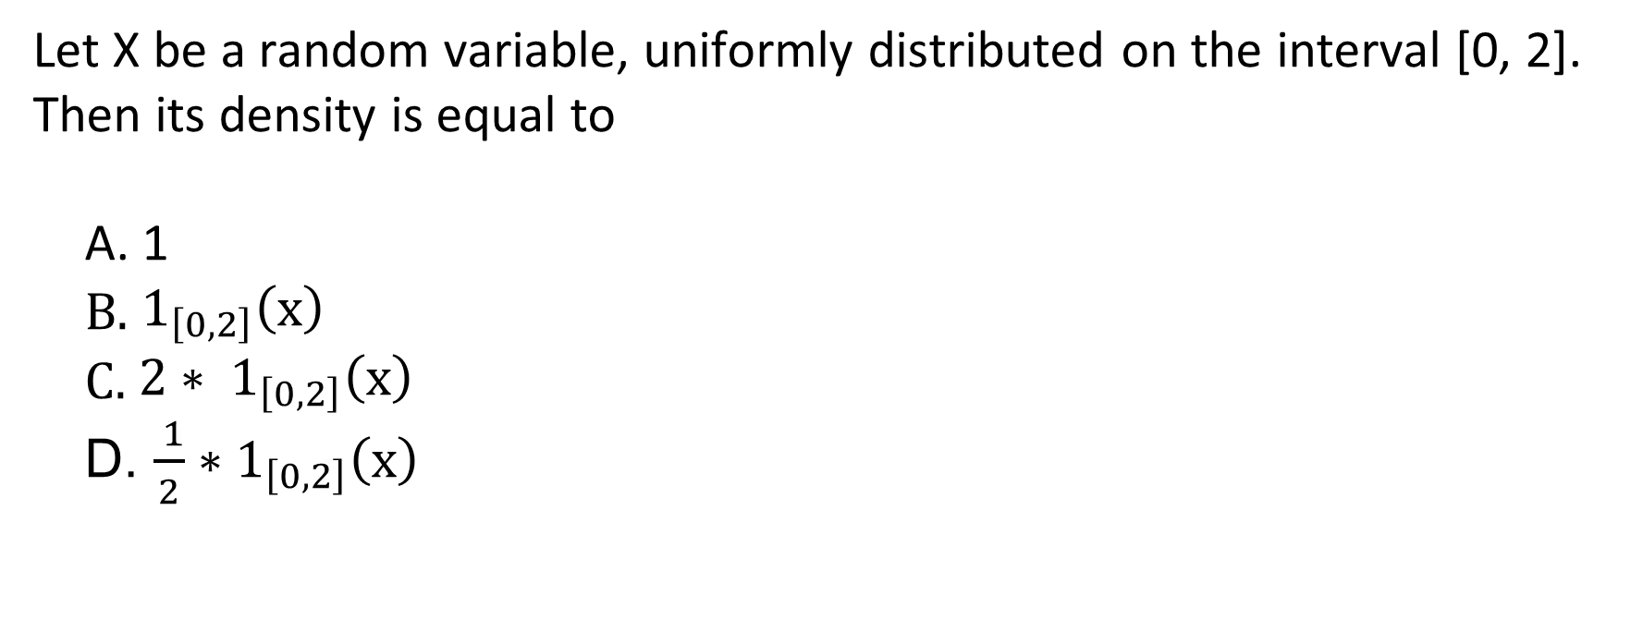
Continuous random variable. Quiz practice
Let X be a random variable, uniformly distributed on the interval [0, 2]. Then its density is equal to
1
${ 1}_{\left[0,2\right]}\left(x\right)$
$2∗ 1_{\left[0,2\right]}\left(x\right)$
$\frac{ 1}{2}∗1_{\left[0,2\right]}\left(x\right)$

Slide 18
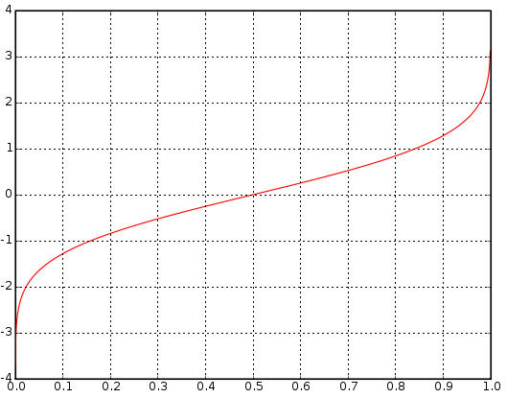
Probability review. Quantile
For a continuous distribution P, quantile Q of a probability level p is a number such that P(X≤Q) = p.
And in terms of strictly monotone cdf F, quantile function is cdf’s inverse: Q=F⁻¹
Read "Definition 2.10.1" in "Probability and Statistics The Science of Uncertainty", by Evans and Rosenthal, at URL
http://www.utstat.toronto.edu/mikevans/jeffrosenthal/chap2.pdf
Some content of this slide is taken from https://en.wikipedia.org/wiki/Quantile_function

Slide 19
Quantile. Quiz practice
Let X be a random variable, uniformly distributed on the interval [0, 1]. What is its quantile, corresponding to probability level 0.25?
0
0.5
0.25
4

Slide 20
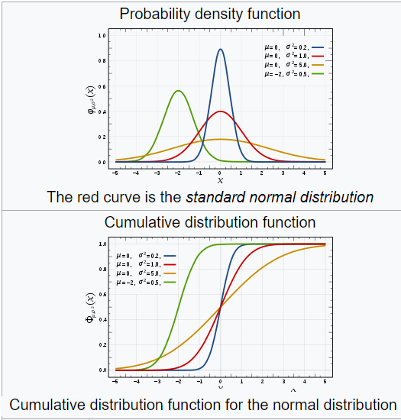
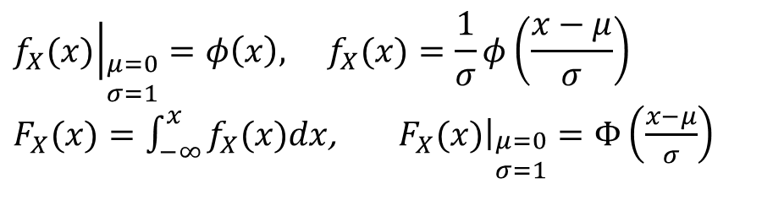
Probability review. Normal distribution
Standard and normal:
$${\left.f_{X}(x)\right|}_{\begin{aligned}&μ=0 \\ &σ=1\end{aligned}}=φ\left(x\right), f_{X}(x)=\frac{1}{σ}φ\left(\frac{x−μ}{σ}\right)$$ $F_{X}(x)=\int_{−∞}^{x}{f_{X}(x)dx}$, ${\left.F_{X}(x)\right|}_{\begin{aligned}&μ=0 \\ &σ=1\end{aligned}}=Φ\left(\frac{x−μ}{σ}\right)$
Normal – family; μ, σ -parameters
Read "EXAMPLE 2.4.7 The N(0, 1) Distribution" in "Probability and Statistics The Science of Uncertainty", by Evans and Rosenthal, at URL http://www.utstat.toronto.edu/mikevans/jeffrosenthal/chap2.pdf
Some content of this slide is taken from https://en.wikipedia.org/wiki/Normal_distribution

Slide 21
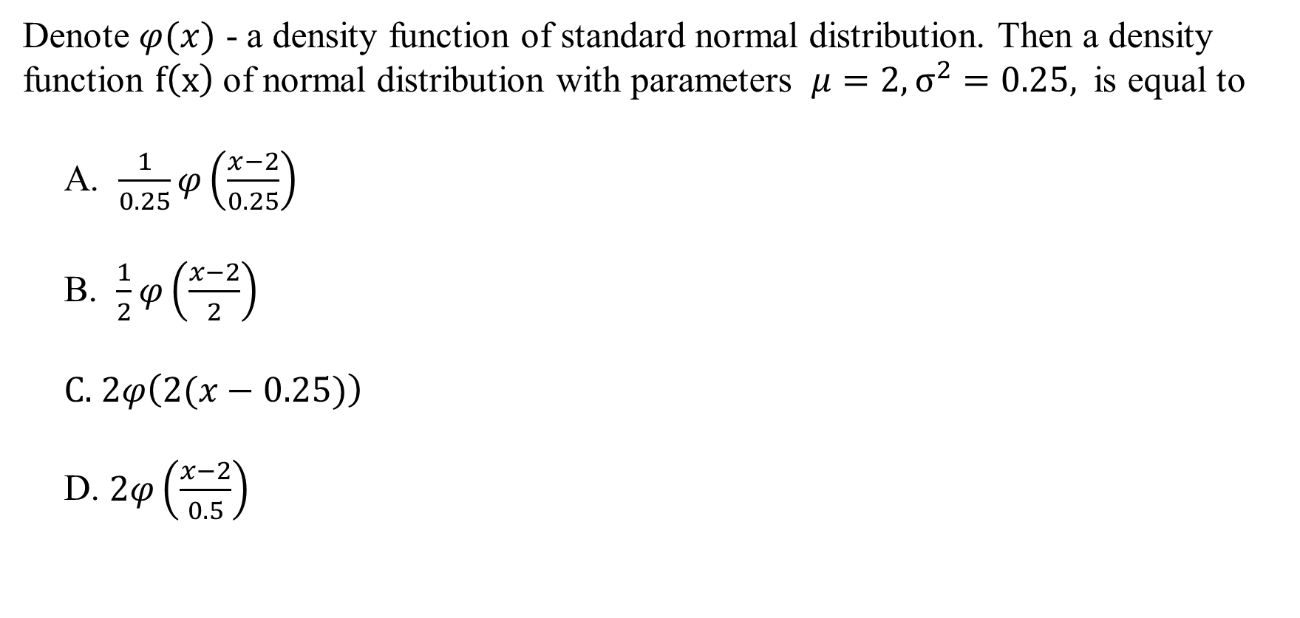
Normal distribution. Quiz practice
Denote $φ(x)$ - a density function of standard normal distribution. Then a density function $f\left(x\right)$of normal distribution with parameters $μ=2, σ^{2}=0.25,$is equal to
$\frac{1}{0.25}φ\left(\frac{x−2}{0.25}\right)$
$\frac{1}{2}φ\left(\frac{x−2}{2}\right)$
$2φ\left(2(x−0.25)\right)$
$2φ\left(\frac{x−2}{0.5}\right)$

Slide 22
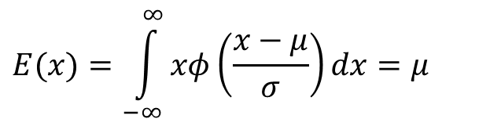
Probability review. Expected value (informally, average)
Discrete:
Continuous:
Example. Uniform {-1, 1}:
f
1/2
x
-1
^{EX = 0}
1
$$E(x)=\int_{−∞}^{∞}{xφ\left(\frac{x−μ}{σ}\right)dx}=μ$$
f
Example. Normal:
x
^{E X = μ}
Read "3.1 The Discrete Case" and "3.2 The Absolutely Continuous Case" in "Probability and Statistics The Science of Uncertainty", by Evans and Rosenthal, at URL http://www.utstat.toronto.edu/mikevans/jeffrosenthal/chap3.pdf

Slide 23
Properties of expectation. Quiz practice
Suppose, X is a random variable, uniformly distributed on the interval [0, 1], and Y is a standard normal random variable. What is the expected value of their sum E(Х+У)?
0
13/12
2
1/2

Slide 24
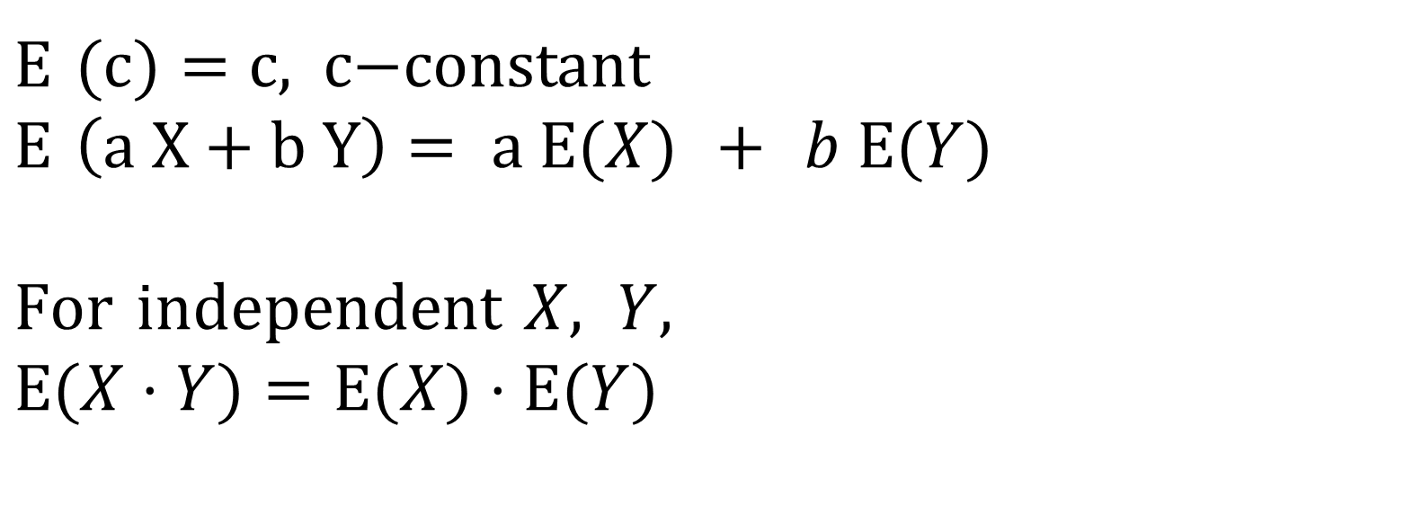
Probability review. Properties of expectation
$Ε (c)=\text{c}\text{, }\text{c}\text{−}\text{const}$ant $$Ε \left(\text{a} \text{X}+\text{b} \text{Y}\right)= \text{a} Ε(X) + b Ε(Y)$$
$$For independent X, Y,$$
$$Ε(X⋅Y)=Ε(X)⋅Ε(Y)$$
Read "3.1 The Discrete Case" and "3.2 The Absolutely Continuous Case" in "Probability and Statistics The Science of Uncertainty", by Evans and Rosenthal, at URL
http://www.utstat.toronto.edu/mikevans/jeffrosenthal/chap3.pdf

Slide 25
Expected value. Quiz practice
Denote X - a random variable, uniformly distributed on the interval [0, 1]. What is expected value E(X)?
0
1/5
2
1/2

Slide 26
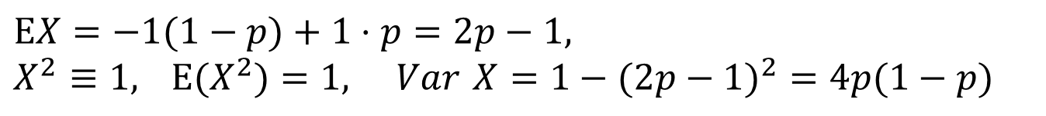
Probability review. Variance
Measure of dispersion
f
$$σ^{2}=Var X=Ε\left[(X−ΕX)^{2}\right]=Ε(X^{2})−(ΕX)^{2}$$
σ
- standard deviation
x
^{μ}
Example. If X ~ N(μ, σ²), Var X= σ²
Example. If
$$ΕX=−1(1−p)+1⋅p=2p−1, \\ X^{2}≡1, Ε(X^{2})=1, Var X=1−(2p−1)^{2}=4p(1−p)$$
Read "3.3 Variance, Covariance, and Correlation" in "Probability and Statistics The Science of Uncertainty", by Evans and Rosenthal, at URL
http://www.utstat.toronto.edu/mikevans/jeffrosenthal/chap3.pdf

Slide 27
Variance. Quiz practice
Denote X - a random variable, uniformly distributed on the interval [0, 1]. What is variance of X?
0
1/5
2
1/12

Slide 28
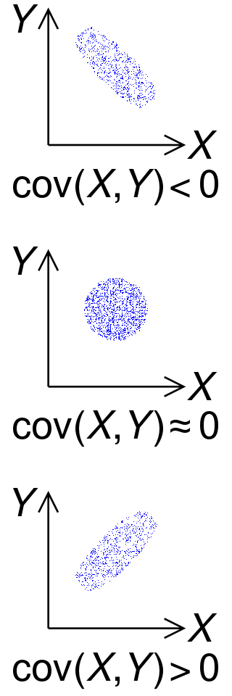
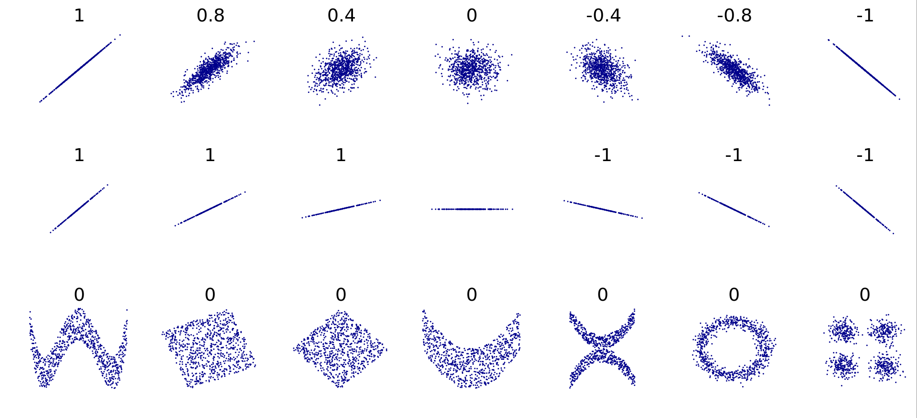
Probability review. Covariance and correlation
Dependence measures
Covariance
Correlation
Read "3.3 Variance, Covariance, and Correlation" in "Probability and Statistics The Science of Uncertainty", by Evans and Rosenthal, at URL http://www.utstat.toronto.edu/mikevans/jeffrosenthal/chap3.pdf
Some content of this slide is taken from https://en.wikipedia.org/wiki/Covariance ,
https://en.wikipedia.org/wiki/Correlation_and_dependence

Slide 29
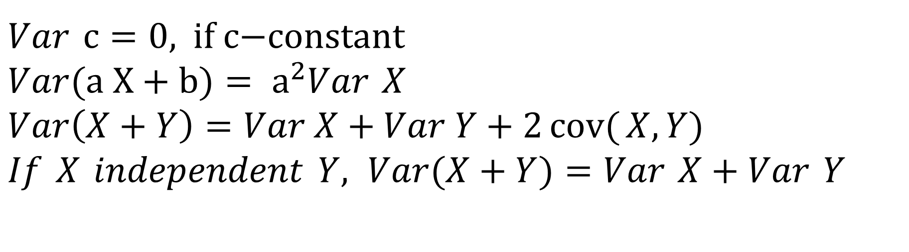
Probability review. Properties of variance
$Var c=\text{0, }\text{if} \text{c}\text{−}\text{const}$ant $$Var(\text{a} \text{X}+b)= {\text{a}}^{2}Var X \\ Var\left(X+Y\right)=Var X+Var Y+2\operatorname{cov}{(}X, Y) \\ If X independent Y, Var(X+Y)=Var X+Var Y$$
Read "3.3 Variance, Covariance, and Correlation" in "Probability and Statistics The Science of Uncertainty", by Evans and Rosenthal, at URL http://www.utstat.toronto.edu/mikevans/jeffrosenthal/chap3.pdf
Some content of this slide is taken from https://en.wikipedia.org/wiki/Variance

Slide 30
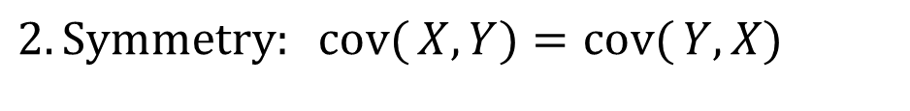
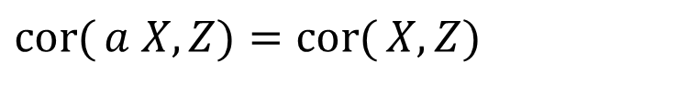
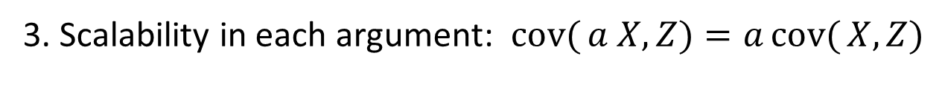
Probability review. Properties of covariance and correlation
Covariance
1. Additivity in each argument
Correlation
Same as for covariance, except
3. Scaling invariance
$$\operatorname{cov}{(}X+Y, Z)=\operatorname{cov}{(}X, Z)+\operatorname{cov}{(}Y,Z)$$
$$2. Symmetry: cov{(}X,Y)=\operatorname{cov}{(}Y,X)$$
$$\operatorname{cor}{(}a X,Z)=\operatorname{cor}{(}X,Z)$$
3. Scalability in each argument: $\operatorname{cov}{(}a X, Z)=a\operatorname{cov}{(}X,Z)$
$$4. If X independent of Y, \operatorname{cov}{(}X,Y)=0$$
Read "3.3 Variance, Covariance, and Correlation" in "Probability and Statistics The Science of Uncertainty", by Evans and Rosenthal, at URL http://www.utstat.toronto.edu/mikevans/jeffrosenthal/chap3.pdf
Some content of this slide is taken from https://en.wikipedia.org/wiki/Covariance , https://en.wikipedia.org/wiki/Correlation_and_dependence

Slide 31
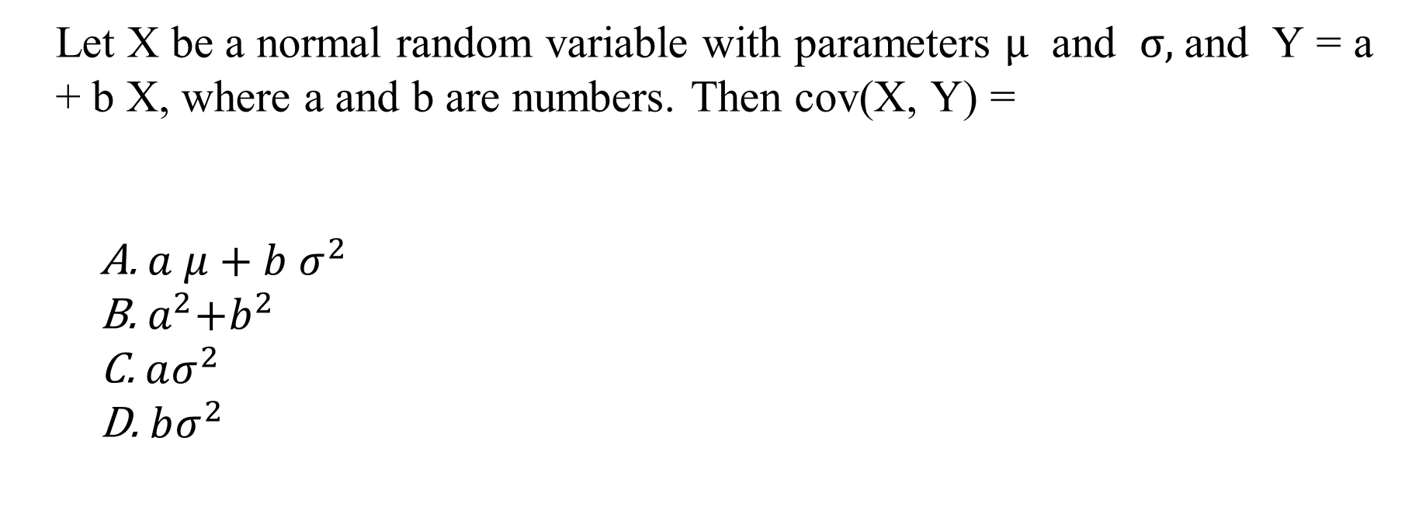
Properties of covariance. Quiz practice
Let X be a normal random variable with parameters $μ$ and $σ,$and Y = a + b X, where a and b are numbers. Then cov(X, Y) =
$a μ+b σ^{2}$
${ a}^{2}+b^{2}$
$aσ^{2}$
$bσ^{2}$

Slide 32
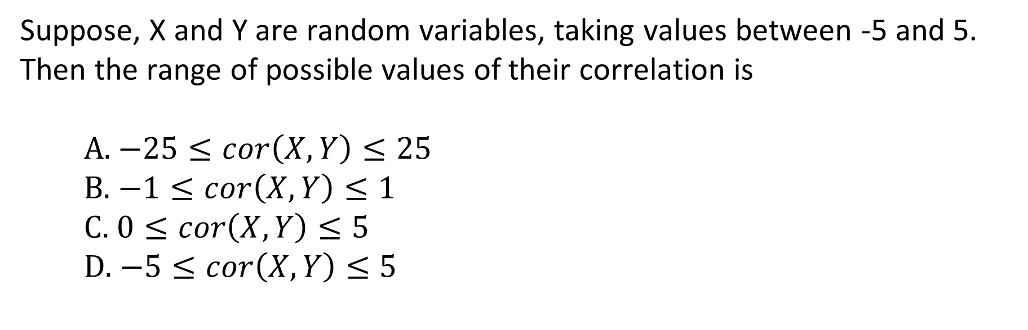
Properties of correlation. Quiz practice
Suppose, X and Y are random variables, taking values between -5 and 5. Then the range of possible values of their correlation is
$−25≤cor\left(X, Y\right)≤25$
$−1≤cor\left(X, Y\right)≤1$
$0≤cor\left(X, Y\right)≤5$
$−5≤cor\left(X, Y\right)≤5$

Slide 33

Probability review. Function of random variable
X – random variable
g:
Y=g(X)
X – discrete r.v. P{X = x_{i}} = p_{i}
EY=Σg(x_{i}) p_{i}
X – continuous r.v. with density f
Read "2.6 One-Dimensional Change of Variable" in "Probability and Statistics The Science of Uncertainty", by Evans and Rosenthal, at URL http://www.utstat.toronto.edu/mikevans/jeffrosenthal/chap2.pdf

Slide 34
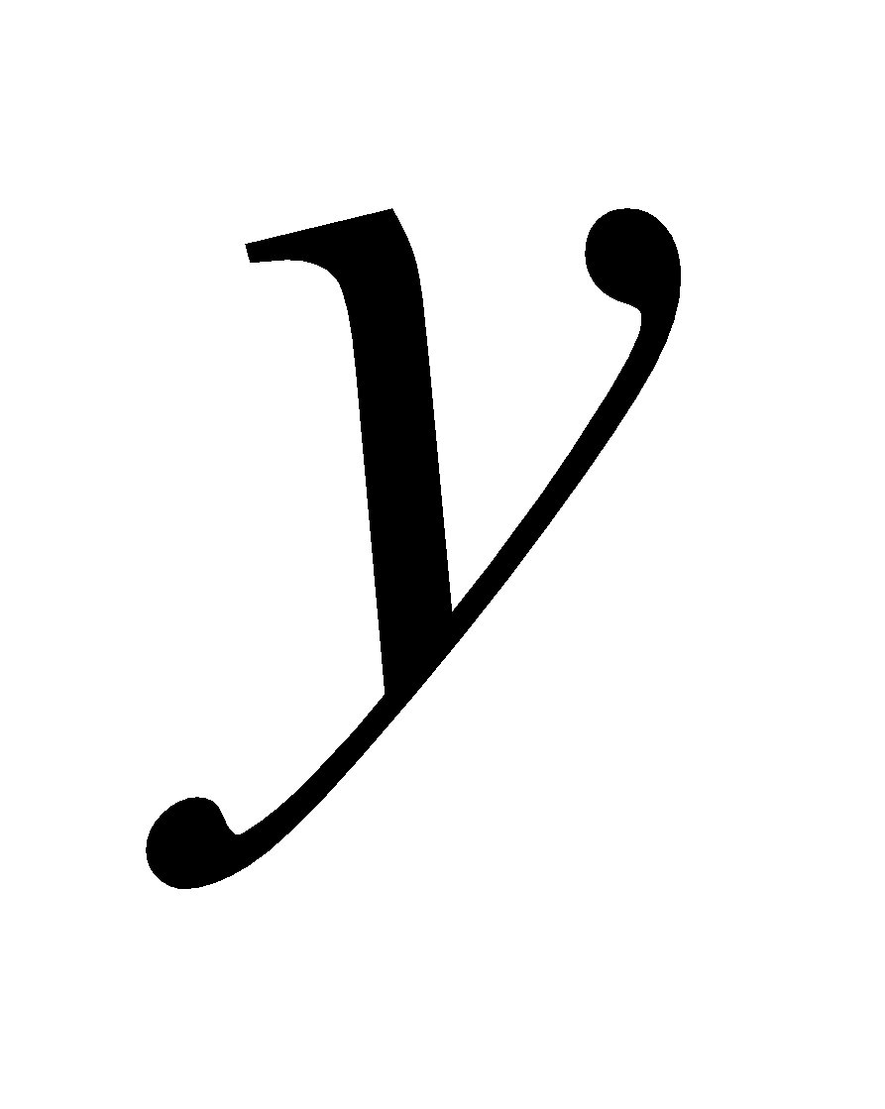
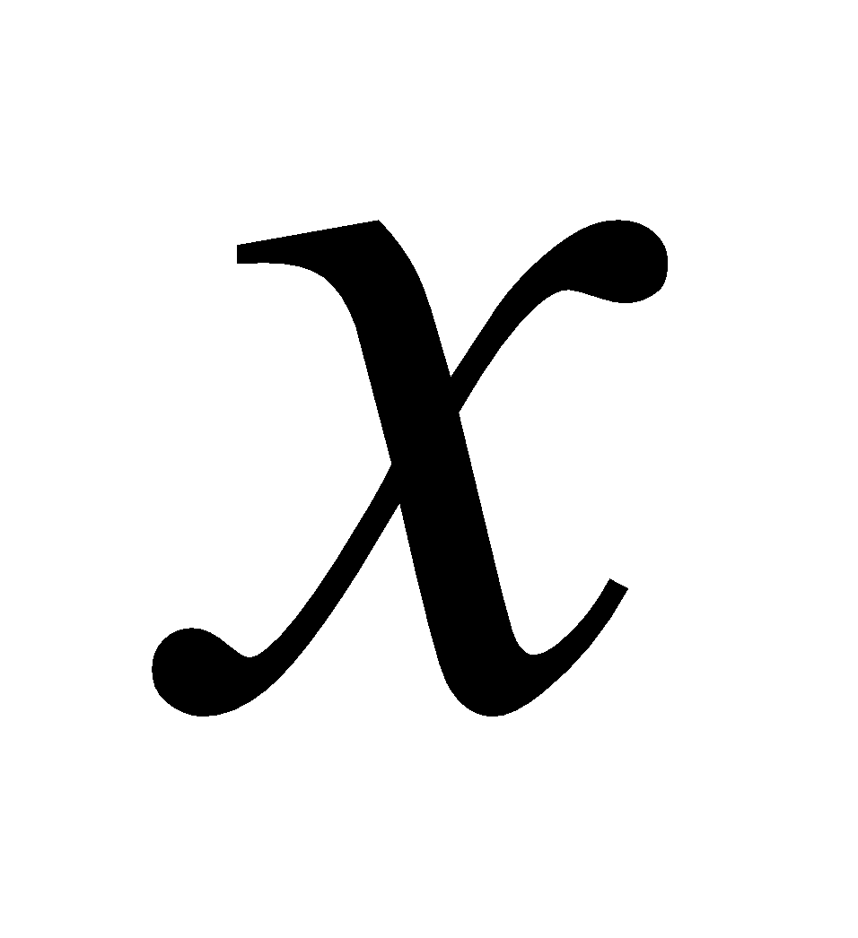
Statistics review. Sample
Collection of values of random variable.
Example X ~ Bernoulli(p)
Sample of size 5: {0, 1, 0, 1, 1}
X
0
1
Bivariate sample
Scatter plot
3
2
1
1
2
2
1
3
3
1
2
3
Read "5.4 Data Collection" in "Probability and Statistics The Science of Uncertainty", by Evans and Rosenthal, at URL http://www.utstat.toronto.edu/mikevans/jeffrosenthal/chap5.pdf

Slide 35
Sample. Quiz practice
For his project, the student collected the sample {180, 149, 176, 130, 162, 155, 194, 145, 147} in the following way. He approached his classmates and asked their height. Is it possible to assume that this sample came from the uniform distribution on the interval [150, 200]?
True
False

Slide 36
Statistics review. Statistic and parameter
Statistic is any function of a sample
Example:
Parameter - any characteristic of a distribution
Example: If ~ N( ), and are parameters
Read "5.3 Statistical Models" in "Probability and Statistics The Science of Uncertainty", by Evans and Rosenthal, at URL
http://www.utstat.toronto.edu/mikevans/jeffrosenthal/chap5.pdf

Slide 37
Parameter. Quiz practice
It is assumed that the sample {X1, X2, X3} is taken from the uniform distribution on the interval [a, b]. In this case, the parameters are
a, b
X1, X2, X3
a, b, X1, X2, X3
None of the above

Slide 38
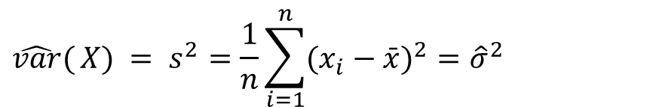

Statistics review. Point estimator
Point estimator - any statistic, created with an intention to approximate a parameter.
Example: Sample mean
Example: Sample variance
Example: Sample covariance:
Example: Sample correlation:
$$\hat{var}{(}X) = s^{2}=\frac{1}{n}\sum_{i=1}^{n}{(x_{i}−\bar{x})^{2}}={\hat{σ}}^{2}$$
$$c\hat{o}r(X,Y)=\hat{cov}(X,Y)/\sqrt{\hat{var}{(}X)⋅\hat{var}(Y)}$$
Read: https://en.wikipedia.org/wiki/Point_estimation

Slide 39
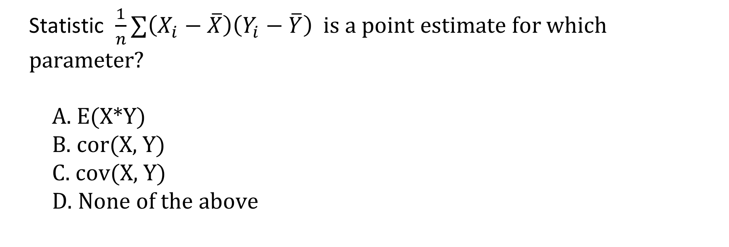
Point estimator. Quiz practice
Statistic $\frac{1}{n}∑\left(X_{i}−\overline{X}\right)\left(Y_{i}−\overline{Y}\right)$ is a point estimate for which parameter?
E(X*Y)
cor(X, Y)
cov(X, Y)
None of the above

Slide 40
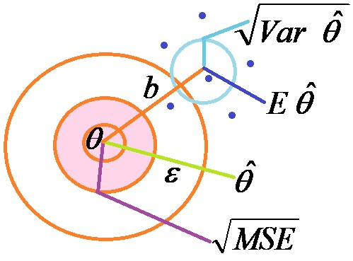
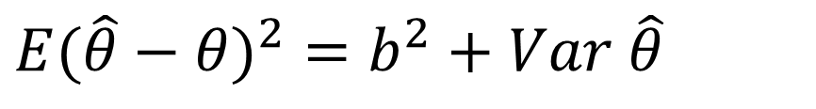
Statistics review. Error, bias and MSE
Error:
Bias:
Variance:
MSE:
(Pythagorean decomposition)
$$E(\hat{θ}−θ)^{2}=b^{2}+Var \hat{θ}$$
Read: https://en.wikipedia.org/wiki/Mean_squared_error

Slide 41
Error. Quiz practice
From the standard normal distribution, we obtained the sample {-0.4, 0.1, 0}. As an estimate of the expected value, we chose an arithmetic mean. What is the error of this estimate on a given sample?
-0.3
-0.1
0.1
Cannot be determined

Slide 42
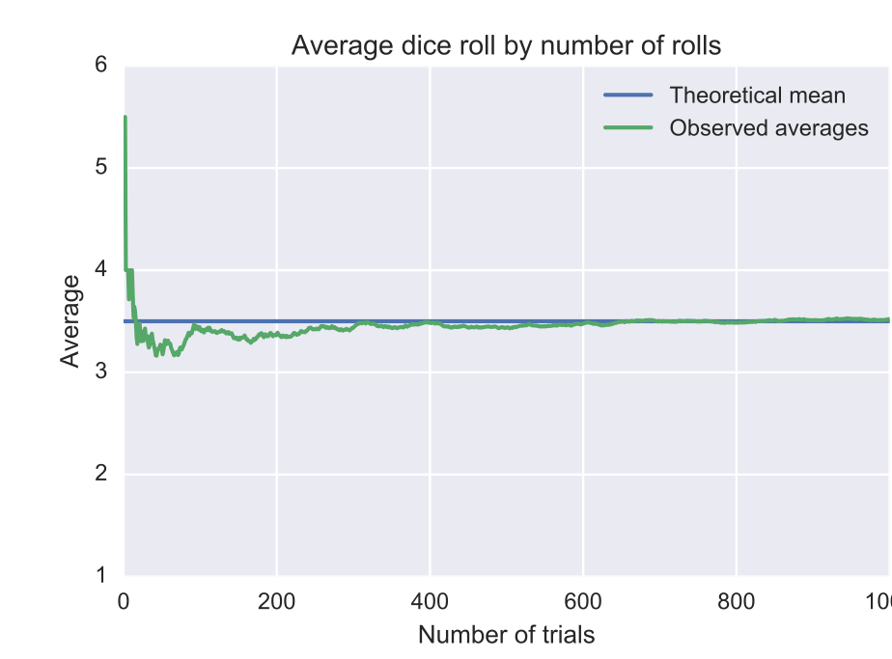
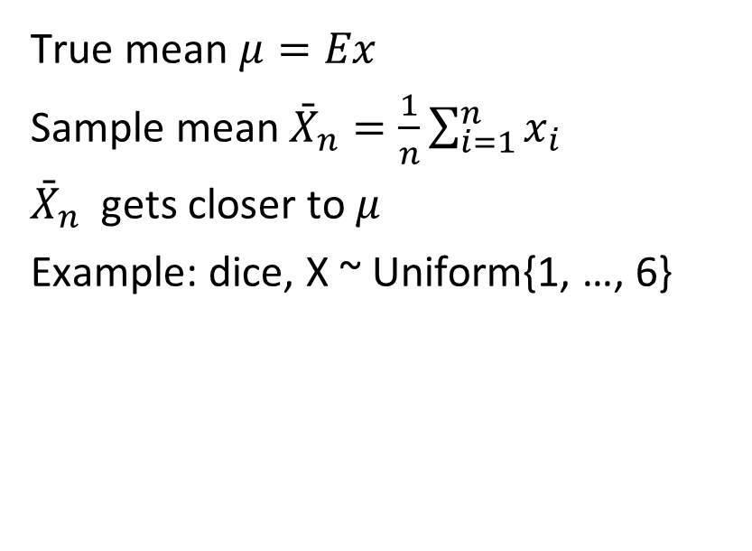

Statistics review. Law of large numbers (LLN)
True mean $μ=Ex$
Sample mean ${\bar{X}}_{n}=\frac{1}{n}\sum_{i=1}^{n}{x_{i}}$
${\bar{X}}_{n}$ gets closer to $μ$
Example: dice, X ~ Uniform{1, …, 6}
$$μ=3.5$$
Read "4.2.1 The Weak Law of Large Numbers" in "Probability and Statistics The Science of Uncertainty", by Evans and Rosenthal, at URL http://utstat.toronto.edu/mikevans/jeffrosenthal/chap4.pdf
Some parts of content are taken from https://en.wikipedia.org/wiki/Law_of_large_numbers

Slide 43
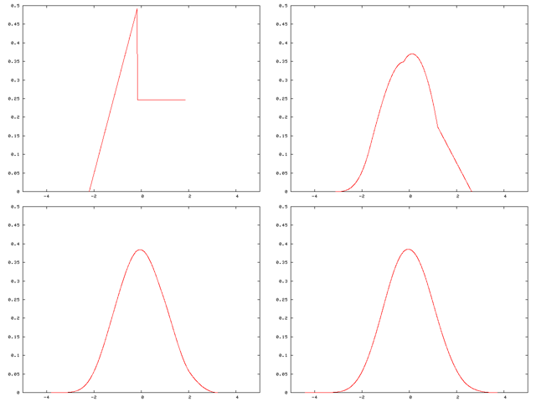
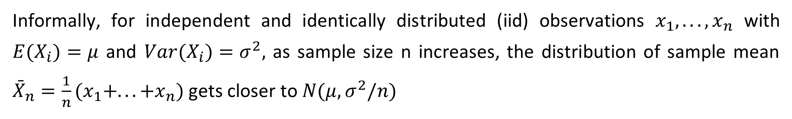
Statistics review. Central limit theorem (CLT)
Informally, for independent and identically distributed (iid) observations $x_{1},...,x_{n}$ with $E(X_{i})=μ$ and $Var(X_{i})=σ^{2},$ as sample size n increases, the distribution of sample mean ${\bar{X}}_{n}=\frac{1}{n}(x_{1}+...+x_{n})$ gets closer to $N(μ,σ^{2}/n)$
A distribution being "smoothed out" by summation, showing original density of distribution and three subsequent summations; see Illustration of the central limit theorem for further details.
Read "4.4.1 The Central Limit Theorem" in "Probability and Statistics The Science of Uncertainty", by Evans and Rosenthal, at URL http://utstat.toronto.edu/mikevans/jeffrosenthal/chap4.pdf

Slide 44
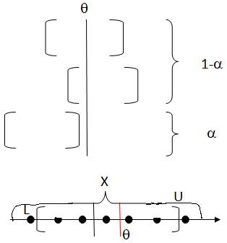
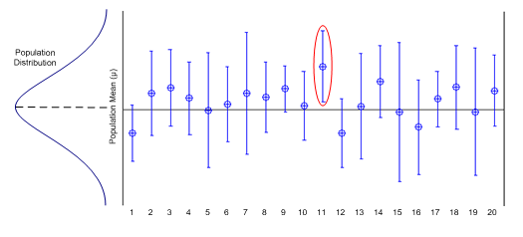
Statistics review. Confidence interval
Sample X={x₁, …, x_{n}}, θ - parameter
P{L(x)< θ<u(x)} = p = 1-α: prob of coverage of θ,
(L(x), U(x)) is a confidence interval
Convenient estimation reporting, including both - locus and precision.
Interval plot for 20 simulated sample sets. Each interval was calculated providing 95% confidence. Note that one interval (circled in red) out of twenty does not cover the known mean representing 5% of the total number of intervals.
Read: https://en.wikipedia.org/wiki/Confidence_interval
Some content is quoted from
https://www.propharmagroup.com/blog/understanding-statistical-intervals-part-1-confidence-intervals/>

Slide 45
Confidence interval. Quiz practice
The Business Survey Department of Statistics Canada collected a sample of revenue of 100 Canadian corporations and reported a 95% confidence interval [50k, 1.6m] for average Canadian business revenue. What is the right interpretation of this fact?
95% of Canadian businesses have a revenue between 50k and 1.6m.
The probability that the sample mean of the 100 collected revenues is between 50k and 1.6m is 95%.
We are 95% confident that the true average revenue of Canadian corporations is between 50k and 1.6m.
The probability that the arbitrary Canadian business has revenue between 50k and 1.6m, is 95%.

Slide 46
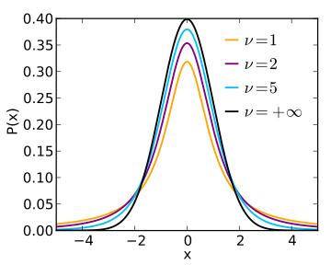
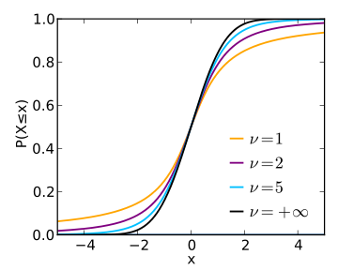
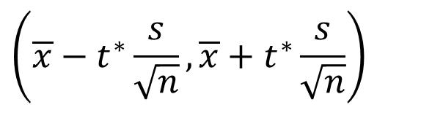
Statistics review. T-confidence interval
To construct a confidence interval for a mean of Normal distribution with sigma unknown, we use t-distribution.
$$\left(\overline{x}−t^{∗}\frac{s}{\sqrt{n}},\overline{x}+t^{∗}\frac{s}{\sqrt{n}}\right)$$
t-distribution has parameter: degrees of freedom.
this test statistic has t-distribution with n-1 degrees of freedom
For constructing a confidence interval we need quantiles of t-distribution. We can compute them, Running R code: qt(p=.975, df = 10)
Read: https://en.wikipedia.org/wiki/Confidence_interval ,
https://en.wikipedia.org/wiki/Student%27s_t-distribution
https://www.cyclismo.org/tutorial/R/confidence.html
Some content is quoted from https://en.wikipedia.org/wiki/Student%27s_t-distribution

Slide 47
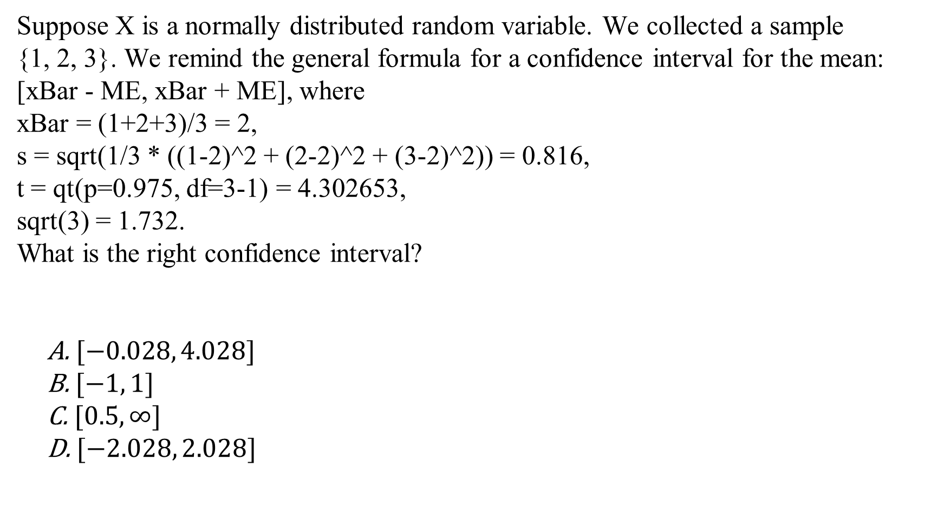
T-confidence interval. Quiz practice
Suppose X is a normally distributed random variable. We collected a sample
{1, 2, 3}. We remind the general formula for a confidence interval for the mean: [xBar - ME, xBar + ME], where
xBar = (1+2+3)/3 = 2,
s = sqrt(1/3 * ((1-2)^2 + (2-2)^2 + (3-2)^2)) = 0.816,
t = qt(p=0.975, df=3-1) = 4.302653,
sqrt(3) = 1.732.
What is the right confidence interval?
$[−0.028, 4.028]$
$[−1, 1]$
$[0.5, ∞]$
$[−2.028, 2.028]$

Slide 48
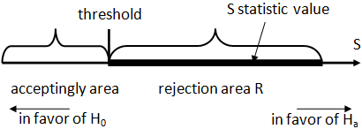


Statistics review. Hypothesis test
A statement about the parameters describing a population
Example, when both hypotheses are simple:
$$H_{0}: θ= θ_{0} ; H_{a}: θ= θ_{a}$$
A statistical hypothesis test compares a test statistic to a threshold.
Confusion matrix
p-value(sample) = P{Given H0, the sample is more in favor of Ha than the one in the LHS}
Read: https://en.wikipedia.org/wiki/Statistical_hypothesis_testing ,
https://en.wikipedia.org/wiki/P-value
Some content is quoted from <https://en.wikipedia.org/wiki/Statistical_hypothesis_testing>

Slide 49



Statistics review. T-test
One-sample t-test
In testing the null hypothesis that the population mean is equal to a specified value $μ_{0}$, with unknown variance $H_{0}: μ= μ_{0} ; H_{a}: μ ≠ μ_{0}$
The test is based on the statistic
$$t=\frac{Z}{s}=\frac{\overline{X}−μ_{0}}{\hat{σ}/\sqrt{n}}$$
Read: https://en.wikipedia.org/wiki/Student%27s_t-test
Some content is quoted from https://en.wikipedia.org/wiki/Student%27s_t-test

